Slide 1


AUGMENTED REALITY
Ruben S. Largo Jr.
Jaynie Israel
Carla Marie Bague
Karyl May Berame
Johnbert Clint Magalona

Slide 2
OVERVIEW OF AUGMENTED REALITY

Slide 3
The fundamental idea of AR is to combine, or mix, the view of the real environment with additional, virtual content that is presented through computer graphics. Its convincing effect is achieved by ensuring that the virtual content is aligned and registered with the real objects. As a person moves in an environment and their perspective view of real objects changes, the virtual content should also be presented from the same perspective Augmented reality (AR) is a form of emerging technology that allows users to overlay computer generated content in the real world. AR refers to a live view of a physical real-world environment whose elements are merged with augmented computer-generated images creating a mixed reality.

Slide 4
The augmentation is typically done in real-time and in semantic context with environmental elements. By using the latest AR techniques and technologies, the information about the surrounding real world becomes interactive and digitally usable. Through this augmented vision, a user can digitally interact with and adjust information about their surrounding environment. Augmented Reality (AR) as a real-time direct or indirect view of a physical real-world environment that has been enhanced/augmented by adding virtual computer-generated information to it. Augmented reality is the integration of digital information with the user’s environment in real time. Unlike virtual reality, which creates a totally artificial environment, augmented reality uses the existing environment and overlays new information on top of it. A live direct or indirect view of a physical, real-world environment whose elements are augmented by computer-generated sensory input such as sound, video, graphics or GPS data

Slide 5
Virtual reality (VR), Augmented Reality (AR) vs Mixed reality (MR)

Slide 6
Virtual Reality (VR) VR is fully immersive, which tricks your senses into thinking you’re in a different environment or world apart from the real world. Using a head-mounted display (HMD) or headset, you’ll experience a computer-generated world of imagery and sounds in which you can manipulate objects and move around using haptic controllers while tethered to a console or PC. It is also called a computer-simulated reality. It refers to computer technologies using reality headsets to generate realistic sounds, images and other sensations that replicate a real environment or create an imaginary world. Advanced VR environment will engage all five senses (taste, sight, smell, touch, sound), but it is important to say that this is not always possible.
Using VR devices such as HTC Vive, Oculus Rift or Google Cardboard, users can be transported into a number of real-world and imagined environments. The most advanced VR experiences even provide freedom of movement – users can move in a digital environment and hear sounds. Moreover, special hand controllers can be used to enhance VR experiences.
Most VR headsets are connected to a computer (Oculus Rift) or a gaming console (PlayStation VR) but there are standalone devices (Google Cardboard is among the most popular) as well. Most standalone VR headsets work in combination with smartphones – you insert a smartphone, wear a headset, and immerse in the virtual reality

Slide 7
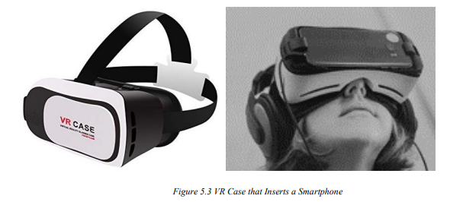

Slide 8
Augmented Reality (AR) In augmented reality, users see and interact with the real world while digital content is added to it. If you own a modern smartphone, you can easily download an AR app and try this technology.
Example of Immersive Technology There’s a different way to experience augmented reality, though – with special AR headsets, such as Google Glass, where digital content is displayed on a tiny screen in front of a user’s eye. AR adds digital elements to a live view often by using the camera on a smartphone. Examples of augmented reality experiences include Snapchat lenses and the game Pokemon Go. Augmented Reality (AR) is a live, direct or indirect view of a physical, real-world environment whose elements are augmented (or supplemented) by computer-generated sensory input such as sound, video, graphics or GPS data

Slide 9
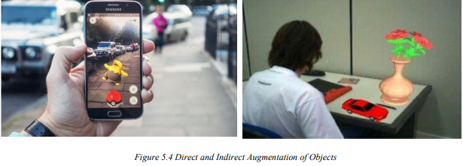

Slide 10
Mixed Reality (MR) Mixed Reality (MR), sometimes referred to as hybrid reality, is the merging of real and virtual worlds to produce new environments and visualizations where physical and digital objects co-exist and interact in real-time. It means placing new imagery within a real space in such a way that the new imagery is able to interact, to an extent, with what is real in the physical world we know For example, with MR, you can play a virtual video game, grab your real-world water bottle, and smack an imaginary character from the game with the bottle. Imagination and reality have never been so intermingled. The key characteristic of MR is that the synthetic content and the real-world content are able to react to each other in real-time.

Slide 11
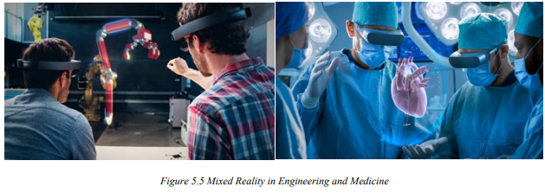

Slide 12
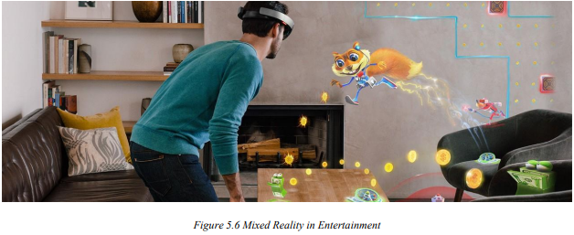
In mixed reality, you interact with and manipulate both physical and virtual items and environments, using next-generation sensing and imaging technologies. MR allows you to see and immerse yourself in the world around you even as you interact with a virtual environment using your own hands—all without ever removing your headset.

Slide 13
It provides the ability to have one foot (or hand) in the real world, and the other in an imaginary place, breaking down basic concepts between real and imaginary, offering an experience that can change the way you game and work today. One of the most obvious differences among augmented reality, virtual reality, and mixed reality is the hardware requirements and also VR is content which is 100% digital and can be enjoyed in a fully immersive environment, AR overlays digital content on top of the real-world. and MR is a digital overlay that allows interactive virtual elements to integrate and interact with the real-world environment. Numerous augmented reality apps and games can run on almost every smartphone on the market. On the other hand, virtual reality programs require specialized VR headsets, noise-canceling headphones, cameras to track room space and boundaries, and sometimes even motion capture technology. Some of the biggest names in VR tech today are the Oculus Rift, HTC Vive, and PlayStation VR. For the enjoyment of simple VR videos, there are affordable makeshift VR headsets like the Google Cardboard, which work by running a video in 360 modes on your smartphone and inserting the phone into the headset. Mixed reality hardware is still emerging and hasn’t quite broken into the mainstream consumer market, most likely due to the price. The consumer releases of the Microsoft HoloLens and Magic Leap One retail for over $2000 USD, which is 3 to 4 times the cost of the PlayStation VR and HTC Vive VR headsets. However, mixed reality applications sometimes require exponentially more processing power and thus require more powerful hardware. For example, the Microsoft HoloLens includes a built-in microphone array, binaural sound capabilities, a built-in camera for recording, a depth sensor, head-tracking cameras, and an inertial measurement unit which helps track your head movement. On top of the traditional CPU and GPU, Microsoft also created a Holographic Processing Unit to help track where the user is looking and understand command gestures.

Slide 14
THE ARCHITECTURE OF AR SYSTEMS

Slide 15
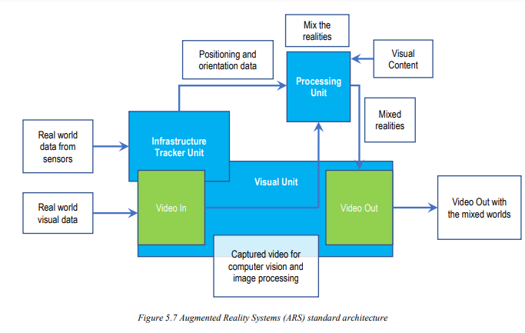
The first Augmented Reality Systems (ARS) were usually designed with a basis on three main blocks, as is illustrated (1) Infrastructure Tracker Unit, (2) Processing Unit, and (3) Visual Unit. The Infrastructure Tracker Unit was responsible for collecting data from the real world, sending them to the Processing Unit, which mixed the virtual content with the real content and sent the result to the Video Out module of the Visual Unit. Some designs used a Video In, to acquire required data for the Infrastructure Tracker Unit.

Slide 16
The Visual Unit can be classified into two types of system, depending on the followed visualization technology:
Video see-through: It uses a Head-Mounted Display (HMD) that employs a video-mixing and displays the merged images on a closed-view HMD.
Optical see-through: It uses an HMD that employs optical combiners to merge the images within an open-view HMD. HMDs are currently the dominant display technology in the AR field. However, they lack in several aspects, such as ergonomics, high prices and relatively low mobility due to their sizes and connectivity features. An additional problem involving HMD is the interaction with the real environment, which places virtual interactive zones to the user, making the collision with these zones hard due to the difficulty to interact with multiple points in different depths. Alternative approaches to developing ARS involve the use of monitors and tablets. Monitors are used as an option for indirect view since the user does not look directly into the mixed world. Tablets are used in direct view since the user points the camera to the scene and looks directly into the mixed world. Both approaches still have difficulties in getting a collision. Processing Unit Infrastructure Tracker Unit Video In Video Out Positioning and orientation data Mix the realities Mixed realities Real world visual data Captured video for computer vision and image processing Video Out with the mixed worlds Real world data from sensors Visual Content Visual Unit

Slide 17
Applications of AR Systems

Slide 18
AR In education Augmented reality allows flexibility in use that is attractive to education. AR technology can be utilized through a variety of mediums including desktops, mobile devices, and smartphones. The technology is portable and adaptable to a variety of scenarios. AR can be used to enhance content and instruction within the traditional classroom, supplement instruction in the special education classroom, extend content into the world outside the classroom, and be combined with other technologies to enrich their individual applications. More importantly, the following reasons for using augmented reality in education: • Affordable learning materials – posters, digital illustrations, physical models, prototypes are very expensive and it’s impossible for schools to find enough money to purchase all the supplementary materials they would like to. Using AR technology allows for avoiding investments in physical materials. Besides, students can get access to learning materials and interact with them anytime. • Interactive lessons – when AR technology is used in classrooms, students can view models on their own smartphones and get a better idea of the concepts they are studying. That increases engagements and reinforces the learning. • Higher engagement – when teachers integrate augmented reality into their lectures, they attract the attention of their students and make lessons more effective. When students are interested, it is much easier to make them work more productively.

Slide 19
Higher retention – using the AR app, students can get access to augmented models that represent any real objects from a famous monument or work of art to a molecule. Besides, students can get access to a website with specific information. When learning with AR technology, students use different senses and retain more knowledge for a long time. • Boost intellectual curiosity – augmented reality makes students more excited about learning certain subjects. Modern students were born in a digital era so they will always be excited with innovative technologies that can help them learn new ideas and develop their critical thinking skills. When using AR technology in the classroom, teachers can create an authentic learning environment for students with different learning styles.

Slide 20
AR In Medicine Augmented reality is one of the current technologies changing all industries, including healthcare and medical education. The purpose of any invention and technology is to simplify our life. Augmented reality has the potential to play a big role in improving the healthcare industry. Only a few years since the first implementations of augmented reality in medicine, it has already filled an important place in doctors’ and nurses’ routine, as well as patients’ lives. This new technology is enhancing medicine and healthcare towards more safety and efficiency. For now, augmented reality has already made significant changes in the following medical areas: • surgery (minimally invasive surgery); • education of future doctors; • diagnostics; • AR tools may also aid to detect the signs of depression and other mental illnesses by reading from facial expressions, voice tones, and physical gestures.

Slide 21
In medicine, AR has the following applications: 1) Describing symptoms – Have you ever been in a situation when it was hard to describe to the doctor what was bothering you? It is a common problem for all us, the roots of which extend to overreacting and lack of knowledge. And what is most important, it impacts on finding out the accurate diagnosis. The first steps to find the solutions are already made. To increase patients’ education, medical app Aye Decide is using augmented reality to show the simulation of the vision, harmed by the different diseases. It helps patients to understand their conditions and describe correctly their symptoms. 2) Nursing care – About 40% of the first intravenous injections fail, and this ratio is even higher in the case of children and elderly patients. The AccuVein uses augmented reality to cope with this negative statistic. A handheld scanner projects on the skin and shows the patients’ veins. It increases the successful finding of the vein from the first try in 3,5 times. That is why this invention got the greatest recognition among the general public and medical staff. 3) Surgery – In no sphere augmented reality does not have such practical application as in the medicine, especially in surgery, where it literally helps to save lives. Three dimensional reconstructions of organs or tumors will help surgeons become more efficient at surgery operations. For example, spinal surgery, as usually, is a long and difficult process. But with the use of AR, it can reduce the time, cut the risks and improve the results. The Israeli startup Augmedics had created an augmented reality headset for spine surgeons. This technology overlays a 3D model of the CT-scan on the spine, so, the surgeon gets some kind of “X-ray” vision.

Slide 22
4) Ultrasounds – Some time ago ultrasound made a small revolution in medicine. Today, it has another one chance to make the same with using augmented reality. Already a few AR software companies developed handy ultrasound scanner, which with the help of smart glasses works as a traditional one. It is hard to overestimate the usefulness of this technology. Especially when we talk about using it in the developing countries, in military medicine (on the battlefields) and even in the ambulance. 5) Diabetes management – In 2017, the number of people struggle with diabetes reached up to 425 million adults worldwide. And the amount of diagnosed people is increasing every year. In 2014, Google revealed the plans for creating a smart contact lens (Google Contact Lens), in which the main function will be to measure the glucose levels in the tears. It will help people with this disease to live the life they used to, without permanent worries about sugar level in the blood. 6) Navigation – The using AR in navigation apps has already become a “traditional” way. By pointing your phone to the city landscape, you get the information about nearby objects of your interest (museums, hotels, shops, metro stations, etc.). The same way AR can be useful to provide information about the nearest hospitals. For example, the EHBO app helps to find the nearest to you AEDs (automated external defibrillators). Generally, AR provides the following benefits to patients and healthcare workers: • Reduce the risks associated with minimally invasive surgery. • Better informed decisions about the right treatment and illness prevention.• Make procedures more tolerable.• Better aftercare• Medical training and education. • Assistance in medical procedures and routine tasks.

Slide 23

Thank You!
GROUP 3

